Slide 1
Marketing Analytics
PROJECT
Jaismine Kaur
DM 65

Slide 2
Q1. Create 2 charts in excel using the Search volumes for Brand A against Social Mentions for any Brand (A/B/C) provided.

Slide 3
Q2. State the a. Null Hypothesis and b. Alternate Hypothesis statement.
a. Hº - Festivals, covid-19 lockdown, and AQI don’t influence search volume of Brand A
b. H⍺ - Festivals, covid-19 lockdown, and AQI influence search volume of Brand A

Slide 4
Q3. Test the null hypothesis by mentioning if you accept or reject the null hypothesis, and also share the screenshot of the output. (Use excel tool to conduct multivariate analysis & p-value test - regression test on excel tool)
At 95% confidence rate, we cannot reject the null hypothesis because the p-value of Covid-19 lockdown and AQI is < 0.05.

Slide 5
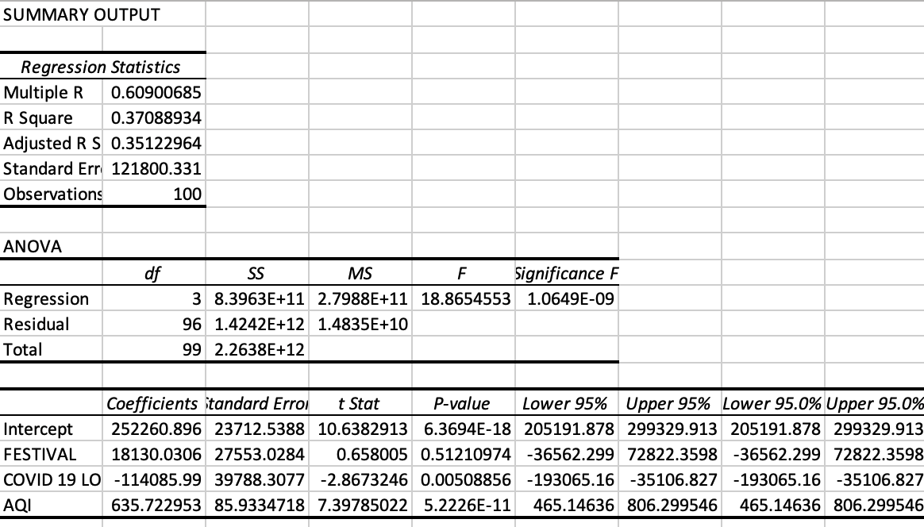

Slide 6
Q4. Please infer as to which other variables from the data set {Pollution (AQI), Festival and Lockdown} are impacting the search volumes for Brand A, and Why?
Out of AQI, festival, and lockdown, Covid-19 lockdown and AQI has an effect on the search volume of brand A (especially AQI) as their p-values are 0.005 and 5.22e-11, which are <0.05, thus following the threshold level of 95% confidence rate.

Slide 7
Q5. Please share your recommendation on which competitor should we focus upon for December and why? (If any)
If we see this line chart comparing social mentions, brand b surpasses brand a at multiple places in social mentions. So Brand b should be focused upon in December.

Slide 8
End of the Project

